Slide 1
Module 2 – Building a Project Database

Slide 2
Before Getting Started
This Module REQUIRES students to have SkySpark installed and the Demo project generated.
Please review Module 1 if these requirements are not met.

Slide 3
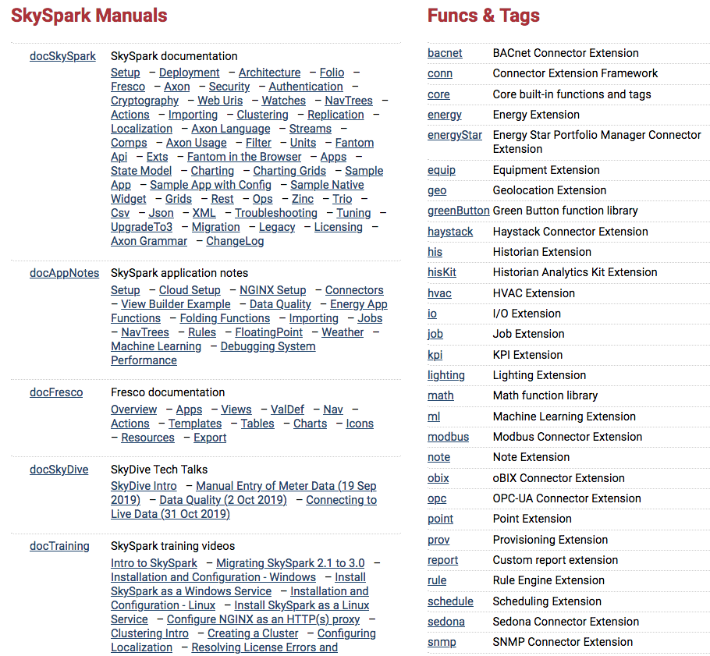
Using the SkySpark Website
Let’s check out the SkySpark website
If you click on Community => Doc, there’s a lot of info there
Including:
Product Documentation
Application notes
Training Videos
Extension docs

Slide 4
The Project Implementation Process
Basic Steps for Starting a Project
Define Project Scope (Discuss potential sparkRules, kpiRules, reports, and visualizations)
Bring in required sites, equip, and points to achieve #1
Connect to data
View Data
Implement sparkRules, kpiRules, reports, and visualizations
View Results

Slide 5
Starting a New Project
Beyond software sizing – implementation factors
Identify data source, type, interface method, frequency of data synching
SQL Ext
CSV / Other File Tools
oBIX, BACnet, Modbus, Haystack, Sedona Connectors – for live data that will be logged by SkySpark, or history synching of controller data into SkySpark
Planning Rules and Tags
Start by outlining the top 5-10 sparkRules you want to run
Explore data once you connect – seeing the data with SkySpark’s visualization tools aligned for the first time will give you insight into system behavior and show you additional rules you couldn’t have anticipated
Learn system tags and analytic functions as you go to support the rules

Slide 6
Data Modeling

Slide 7
Data Modeling and Project Haystack
A record is a thing such as a site, equip, or point.
SkySpark data modeling uses tags to define meaning and relationships. This is different from classic relational DB methods.
SkyFoundry supports and follows the Project Haystack methodology and is one of the original founders of Project Haystack.
Project Haystack is a world-wide open source initiative to apply meaning to data from the Internet of Things (IoT).

Slide 8
Tags: The Tool to Model Your Data
Tags define facts about your data.
Highly flexible – create any tag (including custom, non-Haystack tags) to capture any type of information: building size, location, color, year built, type of construction, brand of equipment, etc
Maybe put name-plate tags on equip and run sparkRules against them?
Maybe use a vendor tag to prove one vendor is better than another?
Create as many tags as you want (no real limit), but always follow Project Haystack conventions when possible.
When in doubt, use the Demo project for reference.

Slide 9
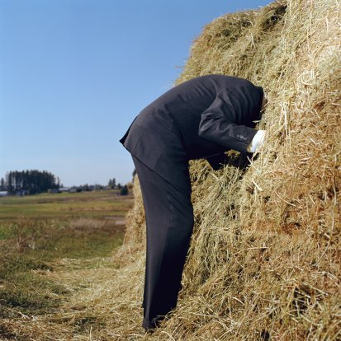
Can you find the needle in the Haystack?
Why use Haystack?
You need a standard
Collaboration with another company
Help from SkyFoundry
When you go back and look at your work 3 years later
Briefly look at discussion forum and tag libraries.

Slide 10
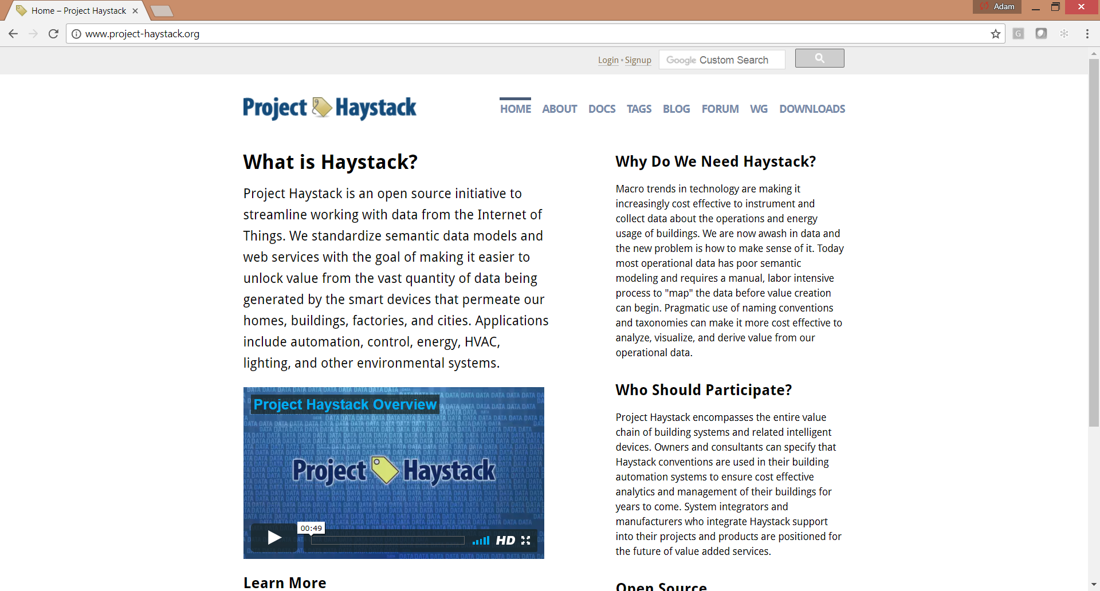
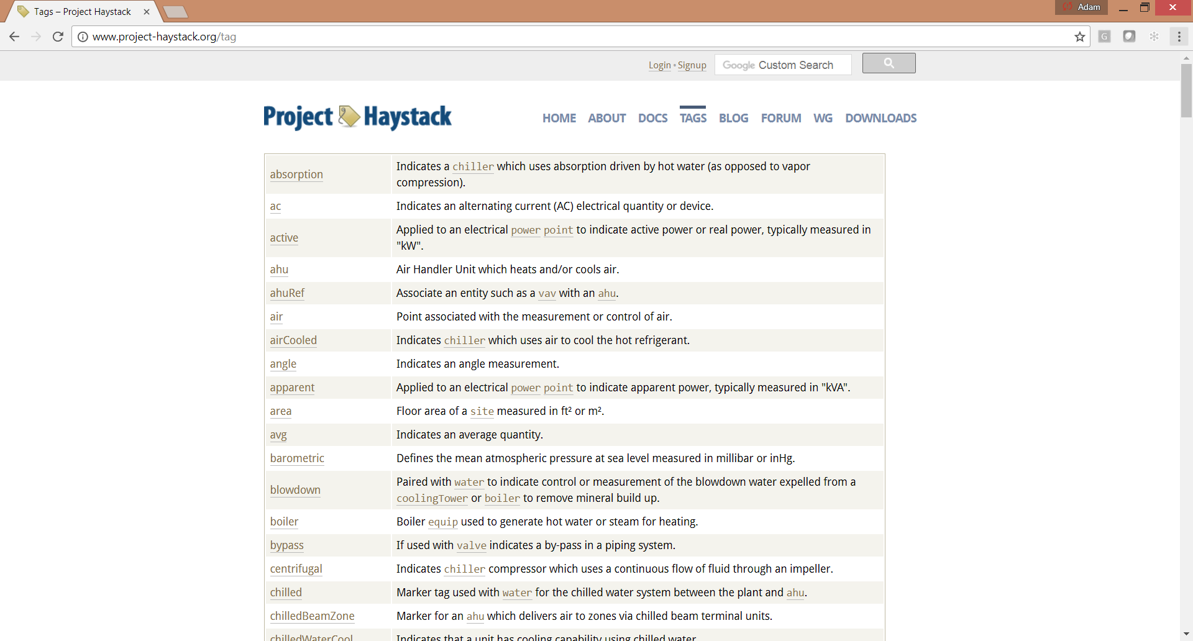
Project Haystack Website
https://project-haystack.org/
Forum with active working groups
Tag definitions
REST API Documentation
https://project-haystack.dev/
Haystack 4 Preview

Slide 11
Folio: The SkySpark Database
Designed for the unique needs of times series machine data aka temporal data.
NoSQL Document-Oriented: no fixed schema, uses tagging – you can model virtually any data
NoSQL Graph-Oriented: efficient traversal of relationships (associations) using ref tags
In-memory RAM database (records and his indices) – high speed analysis of data
Auto-indexing / self-tuning
50k points max recommended per server – some people exceed this limit when synching trend logs <only> and on powerful servers

Slide 12
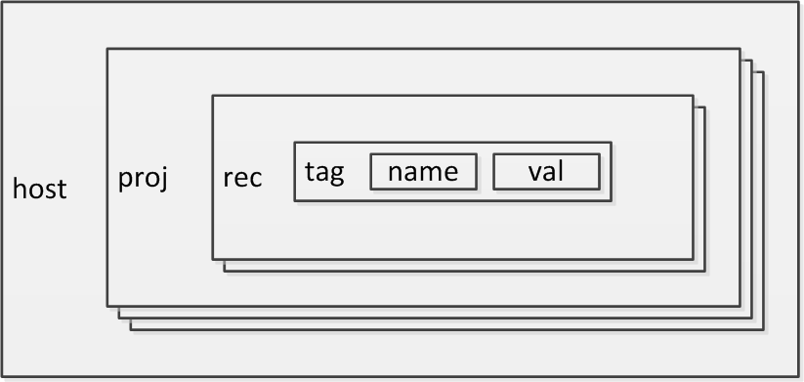
Basic SkySpark Host Structure
SkySpark Host has one or more projects.
Each project has its own Folio database, ensuring data is stored separately.

Slide 13
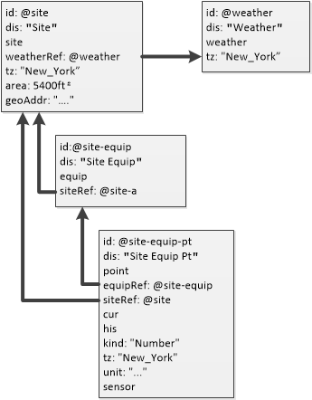
Understanding Data Relationships in SkySpark
Relationships defined by references and tags (SEP model)
Each project has one or more site records.
Each site typically has a reference to a weather station.
Each site has one or more equip records (each equip has a reference to its site).
Each equip has one or more point records (each point has a reference to its site and equip).

Slide 14
Understanding Basic SkySpark Tag Naming Rules
Tag names must start with a lower-case letter.
Camel case => camelCase
The underscore ‘_’ is the only special character allowed.
Spaces are NOT allowed.
Functions, variables, views, apps, etc. must adhere to these rules.

Slide 15
Equipment Model Examples

Slide 16
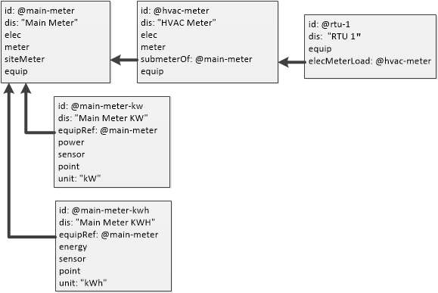
Energy Related Example of Equip within a Site
Vertical and horizontal relationships are possible

Slide 17
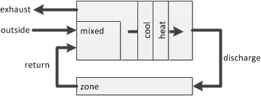
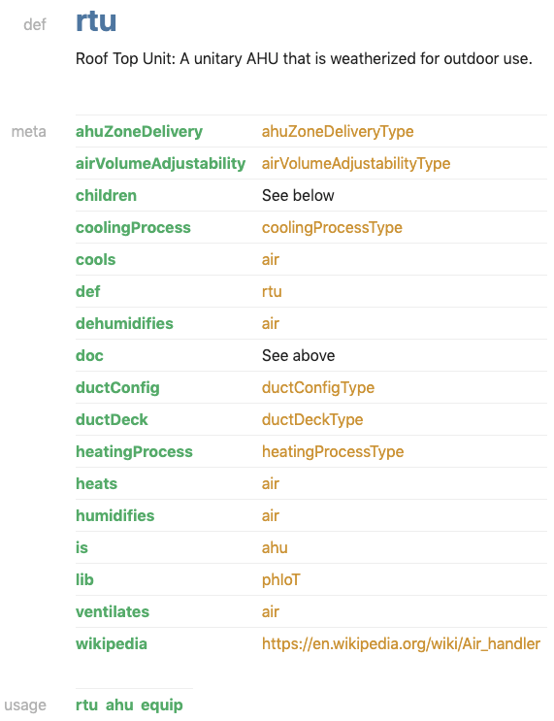

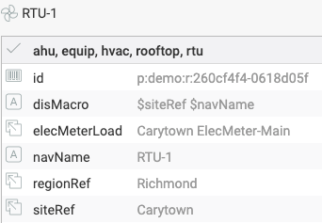
RTU as an Equip Example
fan

Slide 18
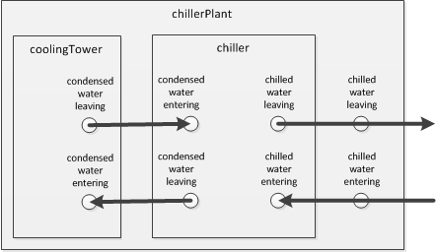
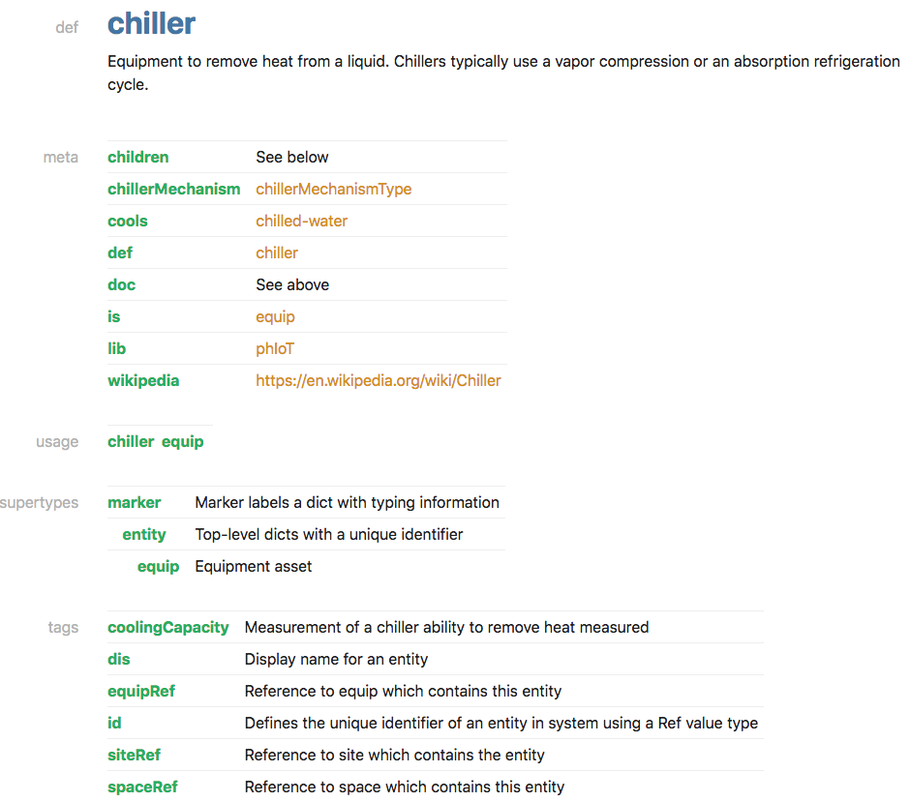
Chiller Plant as an Equip

Slide 19
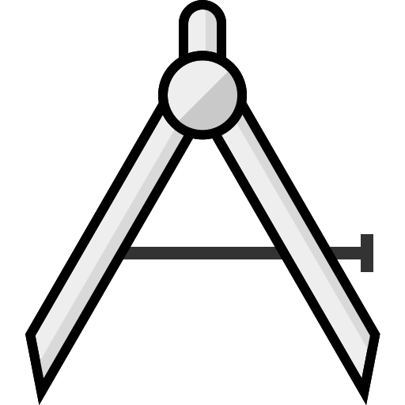

Builder
Host
Host and Builder Application – Creating a Project and Users

Slide 20
Building a SkySpark Database
Using the Host and Builder Apps
Builder
In this training module we will use the Host and Builder App to create a sample project, including a site, equipment, points, users and to import history data.
Manually defining sites, equipment and points is instructive in understanding how relationships and metadata is modeled in SkySpark.
NOTE: SkySpark provides numerous tools for scripting the auto-creation of large projects and that is discussed later in training.

Slide 21
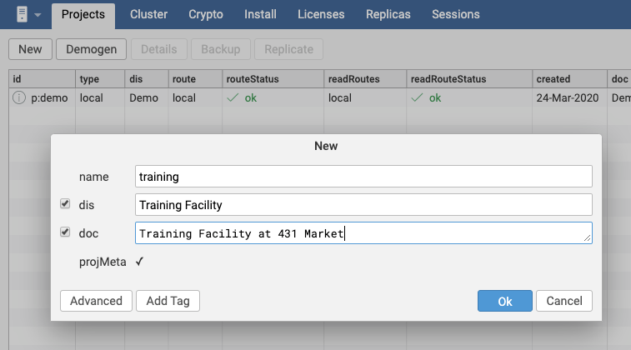
Creating a New Project
Host
Navigate to the Host app.
On the Projects view, click the New button.
Enter name training (note: lower case, min 4 characters).
Enter Display Name and Description (no case restriction – but follow example)
Click Ok.
1
2
3
4
5
Important Note: Timezones are expressed using the Olson Database standard which uses a set of city names to specify timezones
http://en.wikipedia.org/wiki/Tz_database

Slide 22
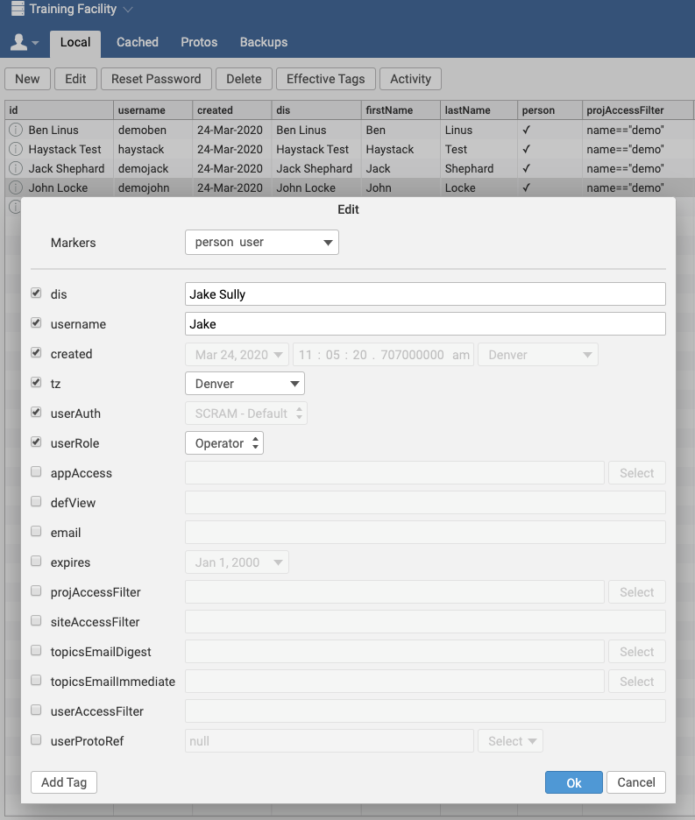
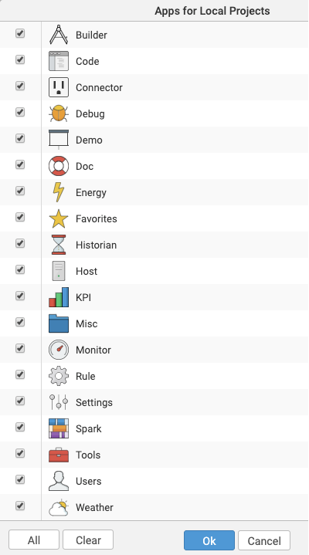
Setting up Users
Host
Open the Users App.
Click New to create a new user.
Enter values for the username tag and the dis tag.
Leave the userRole tag set to Operator.
Click Ok and enter a password for the user.
Remember the user’s username and password. These credentials are stored in the local host and SkyFoundry cannot recover them. The user account is used later in training.

Slide 23
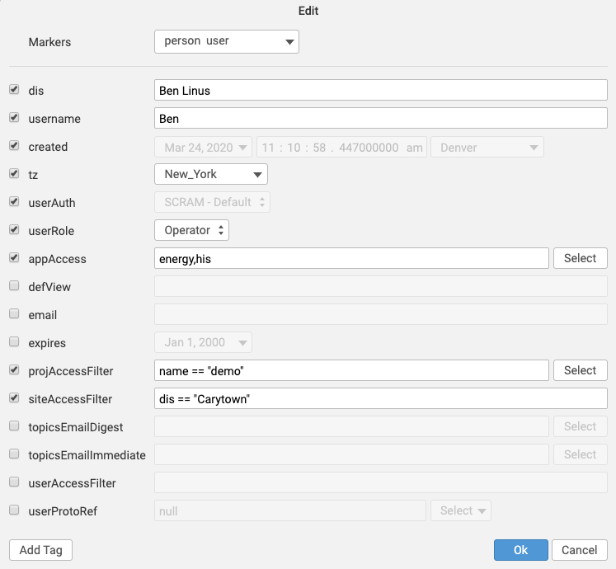
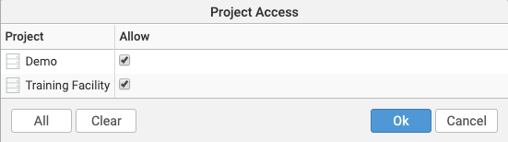
More on User Manager
Host
Click on the user that was just created and click Edit.
Note the projAccessFilter can limit access to projects. Access can be granted based on tags in the projMeta record.
Check appAccess and click Select to control which apps a user can access.
Note: Admins get access to all Apps as a default except the Host app. Operators do not get access to any apps that can write to Folio such as Tools, Code, etc.
Notes:
If projAccessFilter incorrect then you could have. problems during the Haystack exercises in Module 3

Slide 24
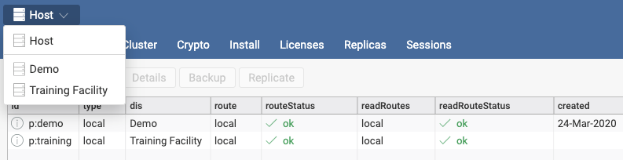
Using the Project Selector to Navigate to Projects
Click on the Project Selector at the top left of the screen.
Click the new Training Facility project from the drop down.
1
2

Slide 25
Builder Application – Creating Site and Weather Station Records

Slide 26
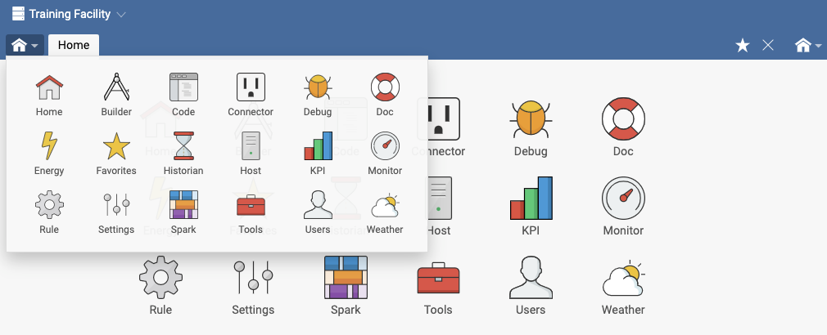
Using the App Selector to Navigate to Apps
Builder
Open the App Selector on the top left (just below the project selector).
Select the Builder App.
1
2

Slide 27
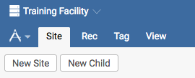
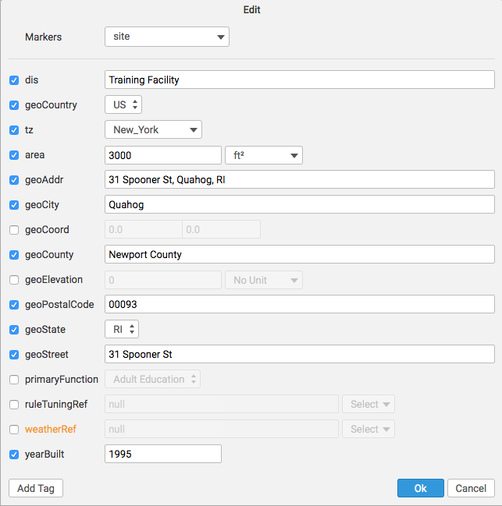
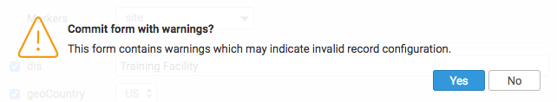
Defining a Site Within a Project
1
Builder
While in the Builder app, on the Site view, click New Site to create a new site record.
Fill in text for the dis tag to define new site display name Training Facility.
Click to add the following tags:
geoCountry = US
area = 3000 ft²
tz = select New York for this exercise
Click Ok.
Click Yes to commit the form with warnings.
2
3
5
6

Slide 28
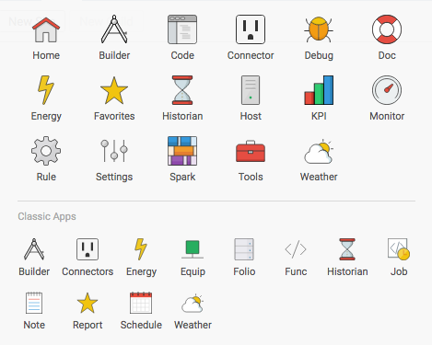
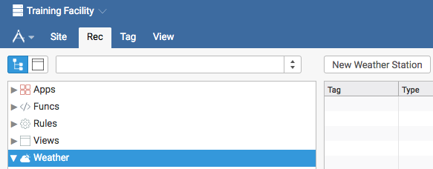
Defining a Site
1
Weather Stations part 1
Builder
Go to the Rec tab (still in Builder).
Click on the Weather group and click on New Weather Station.
2

Slide 29
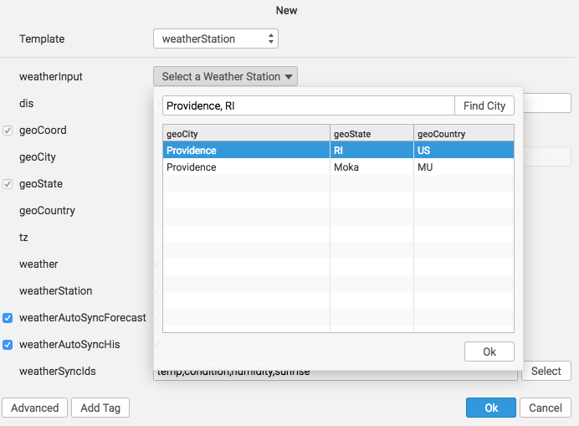
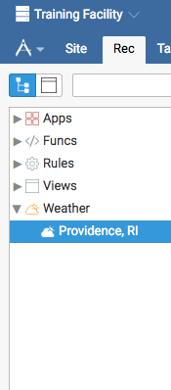
Defining a Site
Weather Stations part 1
3
Builder
3. Click on Select a Weather Station and type in Providence, RI, then double-click on the first entry.
4. Click Ok so that you are back to the Weather group.
4
Note that the weatherSyncIds are the weatherPoints that the project will be subscribed to (4 of 12)

Slide 30

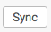
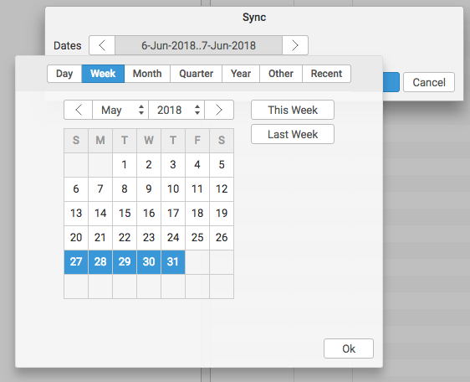
Defining a Site
Weather Stations part 2
Weather
Builder
Sync weather back to Last Week.
Please note that the weather service requires an active internet connection.

Slide 31
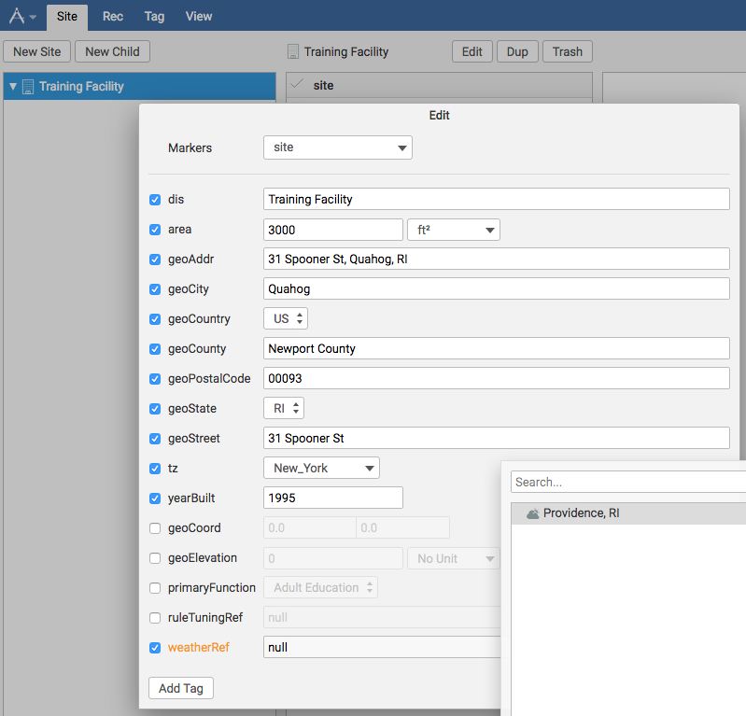
Defining a Site
Weather Stations part 3
Weather
Builder
Go to Site tab – select the Training Facility site and then Edit to add the weatherRef that points to the Providence, RI weather station.
Also note the Degree Days and Forecast tabs in the Weather app
The base temperature is 65°F (all others)
The base temperature is 18°C (metric)
1
Please note that the weather service requires an active internet connection.

Slide 32
Builder Application – Creating Equipment and Point Records

Slide 33
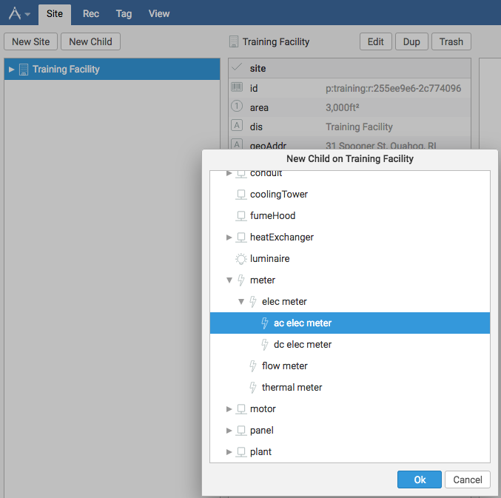
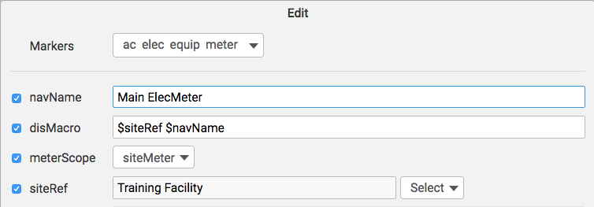
Example: Adding an Equip Record to our Site
Builder
Click Training Facility in the Nav Tree, then click New Child.
In the dialog box, click the arrow to expand equip => meter => elec meter, then click ac elec meter and click Ok.
Change the Navigational Name (navName) of the piece of equipment to Main ElecMeter.
Add the meterScope tag with a value of siteMeter.
Click Ok.
1
2
3
4

Slide 34

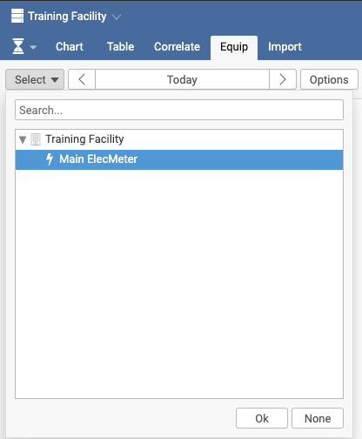
Example: Adding an Equip Record
Verifying our Equip Record
Historian
Go to the Historian App and the Equip tab.
Click on Select and expand the Training Facility site record to see that the equip record exists.
Click Ok.
1
2
NOTE: There is no equipment data yet, but the weather data should be displayed.
3

Slide 35
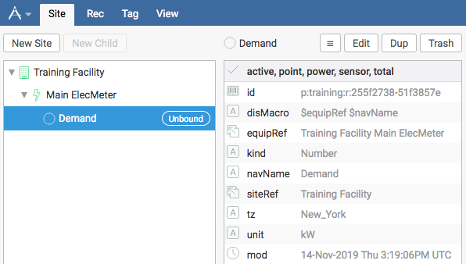
Add a Demand Point Associated with the elecMeter
Builder
Navigate back to the Builder app and Site tab, then expand the Training Facility.
Click on the Main ElecMeter.
Click on New Child.
1
3
2

Slide 36
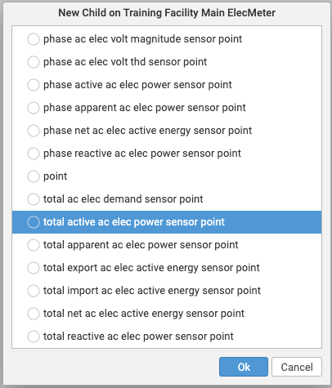
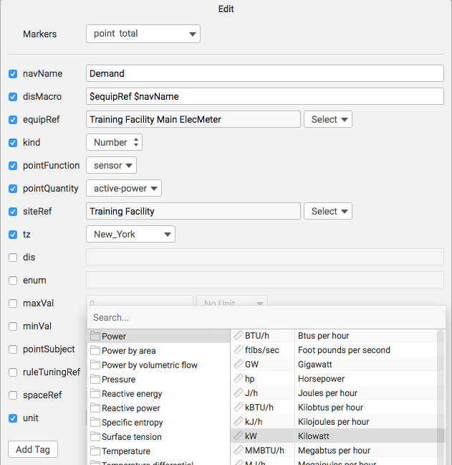
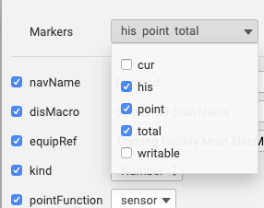
Add a Demand Point Associated with the elecMeter
Builder
In the dialog box, select total active ac elec power sensor point.
Change navName to Demand.
Add unit of kW (since we measure active/real/useful power in kW).
Add the his Marker tag (needed to hold history).
Click Ok – twice.
5
4
7
6

Slide 37
Manually Adding History Data to a Point

Slide 38

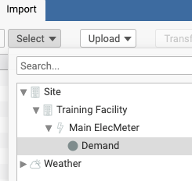
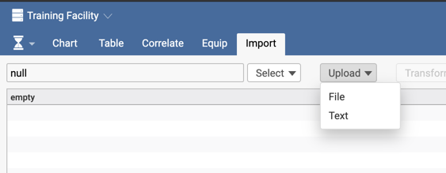
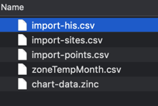
Adding History Data to Our Point part 1 Example using CSV data file included with Demo DB
In the Training Project open the Historian App go to the Import view.
Select the Demand Point under your Main ElecMeter.
Select Upload then File.
Navigate to SkySpark-version/var/proj/demo/io/import-his.csv
Click Upload at the bottom
2
1
4
3
NOTE: SkySpark projects can only read from their own io directory.

Slide 39
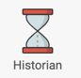
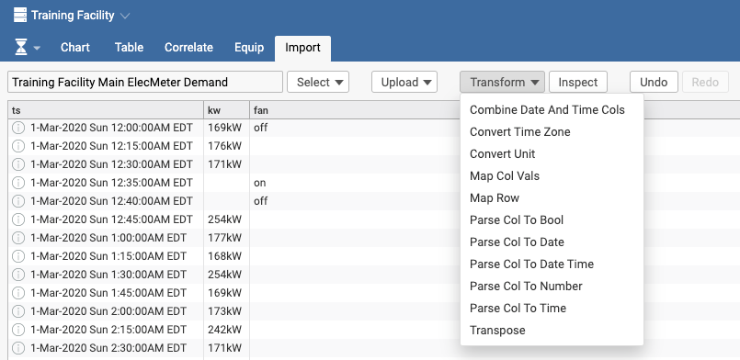
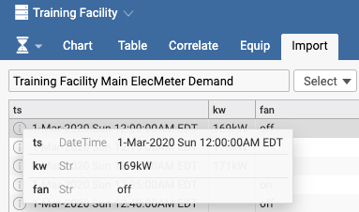
Adding History Data to Our Point part 2
Example using CSV file included with Demo Project
After the file is loaded go to Transform
Click Parse Col to Date Time
Select 'ts' column and then ok.
Remember the hisEnd date shown here.
1
2

Slide 40
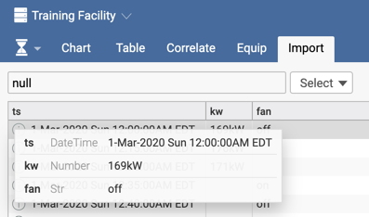
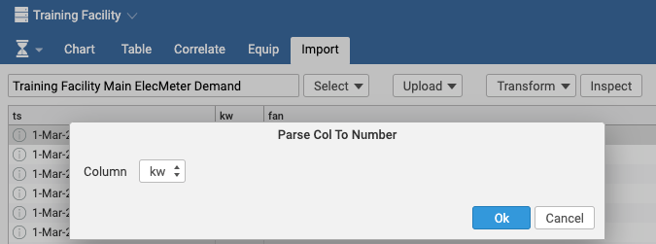
Adding History Data to Our Point part 2
Example using CSV file included with Demo Project
go to Transform
Click Parse Col to Number
Select ‘kw' column and then
Click Ok.
Inspect details
1
5
3
4

Slide 41
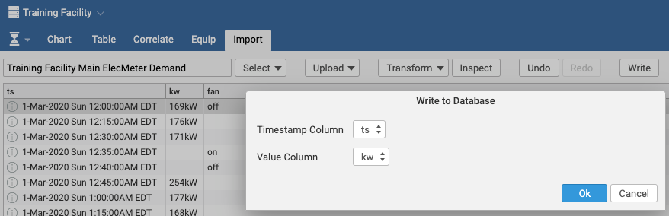
Adding History Data to Our Point part 2
Example using CSV file included with Demo Project
Click Write
Select Timestamp Column as ts
Select Value Column as kw
Click Ok
1
2
3
4

Slide 42
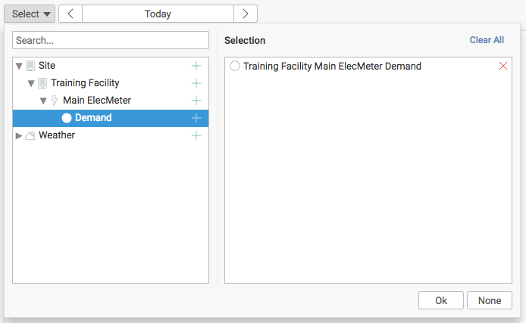
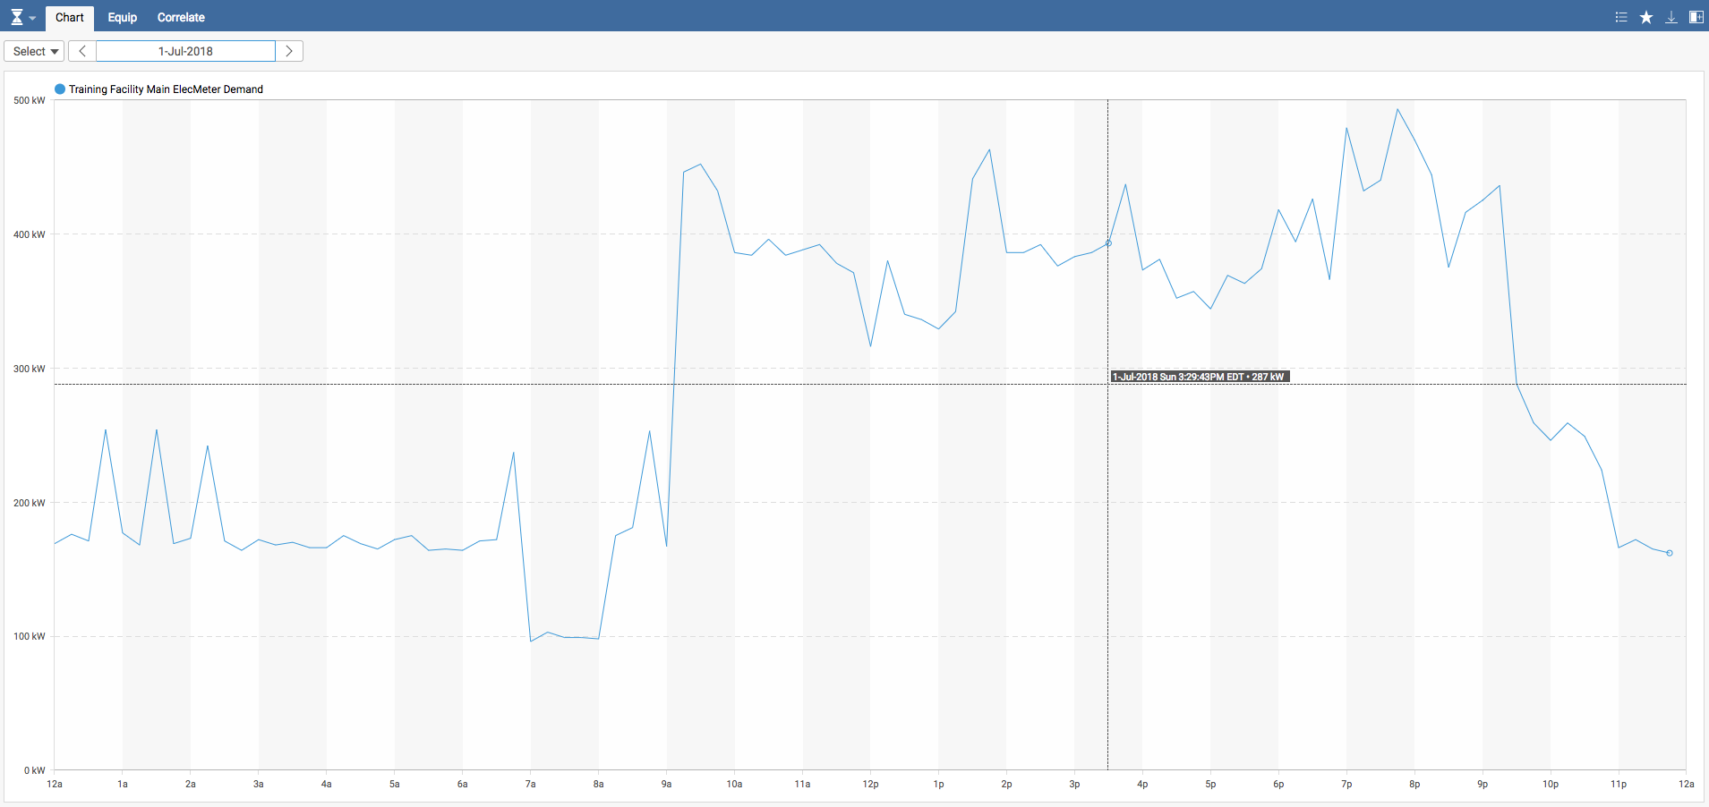
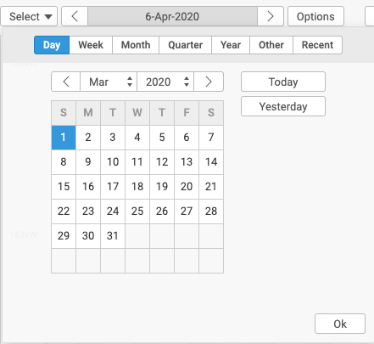
Adding History Data to Our Point
Verify data in the Historian App
Historian
1
Open the new point in the Historian app.
Select the date for the available data (i.e. March 1, 2020).
Verify the kW data is displayed in the chart.
3
2

Slide 43
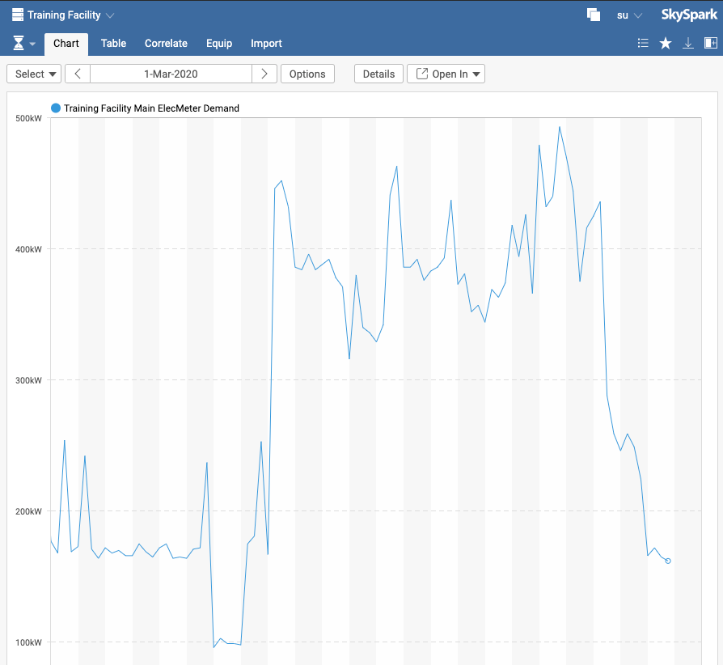

Adding History Data to Our Point
Zooming in and out
Historian
Click anywhere on the chart directly above 8am and drag it to 10am, then release the mouse.
Note that moving the mouse along the chart allows quick comparison of multiple data points with the same timestamp.
Try a vertical zoom.
Click to see the zoom out dialog.
Explore Chart Customization

Slide 44
Historian: Manage and Process Data
Time-series data: stream of timestamp/value pairs (sensors, commands, and setpoints are points with his)
Scale: Scale: 10,000 points × 10years × 15min intervals → 3.5 billion samples
disk_space = points x years x (samples/year) x [average sample size]
Compression:
SkySpark uses 1.5 bytes per sample average for ts and val.
SQL is 8 bytes for datetimes and 1 byte for Booleans and 2 bytes for most numbers (9 or 10 bytes total for most cases)
SkySpark requires 6-7 times less storage space
Data with a set interval compresses better
Smaller size = more speed

Slide 45
Adding Additional Metadata to Records

Slide 46

Add Equip Record for an HVAC Submeter
Builder
In the Builder app, with Main ElecMeter selected, press the Dup button to create a duplicate of the existing meter record.
Click on the duplicate meter record.
Click the Edit button.
Change the navName to HVAC Submeter.
Change the meterScope to submeter.
Add the submeterOf tag and select the original Main ElecMeter.
Click Ok and continue to next slide.
1
3
2
4
5
6

Slide 47


Add Additional Metadata to HVAC Submeter
Builder
Add one more tag before finishing this record: installationDate
Make sure it is a Date type
Use any date such as 09 OCT 2010
Click Ok, then Add
Why is the installation date important?
Might see a change in data
Repair and replacement programs
Maintenance
Warranty
Click Ok to create the new submeter record.
1

Slide 48
End of Module 2 Section 1

Slide 49

Spark Rules (sparkRule) and KPI Rules (kpiRule)

Slide 50
Rules and Functions
Rule
This will be discussed more in depth later in training, but a Function (func) is a set of instructions that return a result.
Find the max demand
Find every period where both heating and cooling was running
Every Rule (rule) has a ruleFunc tag, which is the Function that the Rule will execute.
Rule-ready Functions have a specific set of tags on the func record that simplify creating rule records.

Slide 51

Working with Pre-Built sparkRule-Ready Functions

Slide 52


Activating a sparkRule-Ready Function
Go to the Demo project using the Project Selector.
Click the Rule App.
On the Local tab click New.
Click the KW Exceeds Target in the ruleReady drop down box and click Ok.
Go to Rules | Debug and verify it is 100% populated. See populated to note.
Use the App Selector to navigate to the Spark app.
Click All Sites on the top left.
Rule
1
3
2
4
5
Notice populatedTo field can be changed in Settings | Rule startDate.
This rule will create a spark whenever a site exceeds 400kW.

Slide 53

See if the sparkRule Sparked
Spark
What a result in the Spark app might look like for the Last Month:

Slide 54


Try out Swivel!
Spark
Click on Options (top middle)
Change Site to Rule
Change Rule to Equip
2
3
1

Slide 55

Adding Cost Factors to sparkRules
Rule
Adding Cost factors is EASY
Non-programmers can add cost factors
Use the ruleCost tag in the Spark dialog
Makes spark costing accessible to managers and other users
More complex cost formulas can be implemented using Axon expressions

Slide 56
Adding Cost Factors to sparkRules
Rule
Assign Cost on 3 factors:
Duration of Spark
Period (occurrence)
Per day that a Spark is found
// two discrete periods with total duration of 4hr
9:00 1hr
12:00 3hr
// cost formula examples
“5$ per hour” >>> $20 // $5 x 4hr of duration
“5$ per period” >>> $10 // $5 x 2 discrete periods
“5$ per date” >>> $5 // $5 for entire date

Slide 57

Adding Cost Factors to sparkRules Quick Exercise
Now, go back to the Rule App and double-click on KW Exceeds Target
Add $155 per period to the KW Exceeds Target rule
Also, change the color this rule’s sparks display as. Here, a light red is used.
Check the Spark App before and after you do a recompute
Note that this does not take effect until you do a recompute
Rule
1
3

Slide 58

Working with Pre-Built kpiRule-Ready Functions

Slide 59

Activating a kpiRule-Ready Function
Rule
Go to the Rule app and Local tab again
Click on New again
Utilizing the Auto-fill again, select Watts/ft2 and click Ok
Your kpiRule should now be operating and available
You can disable and enable kpiRules on the current screen as well

Slide 60

Writing a Function and Turning it into a KPI
Viewing Your New KPI
KPI
Go to the KPI app to view the new Watts/ft² kpiRule
Click on All Sites on the top left
1
2
Note that numbers, ranges, and deltas can be displayed

Slide 61


Let’s use Swivel again!
KPI
Click on Options (top middle)
Change Site to Equip
1
2

Slide 62
Normalization and Baseline Functions

Slide 63





Custom Normalization Function | Energy App
energyByRevenue Example Function from the Demo Project
Tools
Energy
First we need to add revenue numbers for each site as shown to the right
Go to the Tools App and type site. Click on the first site and shift click on the last site. Now hit edit.
Note: This is your introduction to batch editing. Be very careful when editing more than one record.
Now, add a tag called revenue (note the colon) with the first number in the following table and put the $ after the number. Think of it as a unit.
Per Site Revenue Values:

Slide 64


Custom Normalization Function | Energy App
Now, go back and make the other sites have the other numbers shown, so we can see a difference when normalizing.
Next, still in Tools, type: readAll(func). Sort by name and select "energyNormByRevenue"
Select edit and and add energyNormFunc as a marker tag on the function
Click OK to save your changes
Go to the Energy app, refresh the screen, and click All Sites
Click on Options, select Normalize by Revenue, and click Ok twice
Do the same for “energyBaselinePrevYearLess10”
function by adding the energyBaselineFunc tag.
Tools
Energy
Per Site Revenue Values:

Slide 65

Deleting Records from Folio
Tools
Builder
Two easy ways to delete stuff:
In the Tools app, select the record or records you want to delete and hit the Trash button
In Builder app, select the Trash button
You still need to go to the Trash tab in the Tools app and either permanently delete or restore the records to permanently remove them. This acts like the Trash in most operating systems.

Slide 66
Tools
Creating Customized Navigation Trees

Slide 67


Including Other Projects – Using Filters
Your 3.0 views will, by default, only work with the current project. To use with other projects, you need to add the projIncludeFilter to your uiMeta record. The projIncludeFilter will check against the projMeta record in other projects. The following will allow Proj “B” Fresco views to see Proj “A”.
Proj “A” has testTag in the projMeta record
Proj “B” has projIncludeFilter: testTag in the uiMeta record
Rule Ext needs to be enabled in all projects to use projInclude filter.

Slide 68
Fresco Navigation
You can control how the record pickers work in all views including ones you create yourself
Your uiMeta record can have the following tags: siteNav, equipNav, or pointNav (or any other navlevel you have in your uiMeta). This will organize the levels as you go to select a given site, equip, point, or whatever else.
A really good example of this is if your sites have geoState and geoCity tags. You can then put the following tag on your uiMeta record (note the “/” for multiple levels):
siteNav: “geoState/geoCity”
siteNav: “geoState” for one level
Note how flexible this makes changing navTrees and that records do not need to exist for these additional levels

Slide 69

Fresco Navigation Practice part 1
While still in the Demo project, go to the KPI app, and note the navigation tree that is currently active. In a minute, we will add geoCity and geoState tags.

Slide 70

Fresco Navigation Practice part 2
Now go to the UI view of the Tools app

Slide 71


Fresco Navigation Practice part 3
Add the tag =>
siteNav: geoState/geoCity to
this record
Query site and note the geoState and geoCity tags:

Slide 72


Fresco Navigation Practice part 4
The the Test Nav button allows you to check your nav path
Check the new site path (make the target => site)
The uiMeta record can also be accessed by querying for the uiMeta tag in the Tools app

Slide 73

Fresco Navigation Practice part 5
Now go to the KPI app and note the changes you’ve made
All apps will use this navigation, so the flow will be geoState/geoCity/site/equip/point
Try removing the Floor level before equip? (Headquarters only)
Settings app => UI tab: equipNav: siteRef/floorRef

Slide 74

Creating Schedules with the Schedule App

Slide 75

Using the Schedule App
Schedule
There is a video on the Schedule app: https://www.skyfoundry.com/doc/docTraining/ScheduleApp
Explore the Schedule in the Tools app (note the schedule tag)
Also note that schedules are demonstrated in the Tariff Write-Up
Just some of the reasons to use schedules
When there is no way to pull schedules from some external systems – SkySpark lets you define them
kW and kWh usage on and off schedule
Rate of change when schedule transitions
Loads on when they shouldn’t be
Don’t forget to enable the ClassicSchedule ext.

Slide 76
Understanding SkySparkⓇ Everywhere™ Distributed IoT Architecture and Clustering

Slide 77


The IoT is a Distributed Computing Challenge
“The reality is that it is not possible, cost effective or desirable to transmit every piece of data from every IoT device to the cloud in order to gain value from that data.
An IoT technology platform needs to recognize and embrace the highly distributed and innately non-hierarchical nature of the IoT and support that with a corresponding software architecture.”

Slide 78
The IoT is a Distributed Computing Challenge
Data collection, storage, processing and analytics needs to be able to be performed at all levels of IoT systems
Similar to how BAS started with highly centralized control systems and then moved to distributed control architectures
Addressing this reality requires a fundamentally different technology architecture than provided by cloud-only solutions

Slide 79
SkySpark Everywhere Distributed Architecture
Provides the ability to apply SkySpark across multiple nodes that work together in unified systems called clusters
Nodes can be small embedded devices, edge gateways, on-premise servers or cloud-hosted servers – the full feature set is included on each node
Provides maximum flexibility, scalability, reliability, and simplicity to meet real the world application needs of distributed systems
Nodes can have licenses as small as 10 points

Slide 80

SkySpark Everywhere™ Distributed Architecture
= SkySpark runs here

Slide 81

A Look at Distributed Architecture Examples
SkySpark cloud-hosted architecture
A good fit in applications where the end devices have local data logging capability.
SkySpark operating at the cloud typically employ synching of trend logs from the end device.
Clustering allows large-scale systems to be distributed over multiple servers for load balancing.
Live polling is supported, but the application designer needs to consider effects of network latency, bandwidth, comm faults and ability of systems to support polling requests.

Slide 82

A Look at Distributed Architecture Examples
SkySpark deployed on premise at the building level
SkySpark connected to local data sources via standard data acquisition connectors.
SkySpark acts as an in-building, facility-level data aggregator.
Provides features far beyond simple data collection and gateway functions - includes all of the capabilities of SkySpark accessible locally without requiring users to access a cloud-based server.
Users can still access the data via the cloud level through secure “tunneling” and replication features, which synch data on a configurable basis to insure compatibility with network limitations.

Slide 83

A Look at Distributed Architecture Examples
SkySpark deployed on edge devices in equipment systems
In this architecture SkySpark is installed on small edge computing platforms (IoT gateways and OEM controller products) that directly control or manage equipment systems or are connected to smart devices or sensors.
Every node can provide local user access to all of the capabilities of SkySpark.

Slide 84
Key Points About Distributed Architecture
Each device host a separate project(s).
Projects are not split across multiple nodes
Internode communications uses the ArcBeam protocol which is a webSocket peer-to-peer protocol. The connection can be initiated from behind a firewall and supports bi-directional communication.
Note: Each Project must have a unique name when using clustering.

Slide 85
The Benefits of a Distributed Architecture
Keep the data on premise
Addresses data security issues – many applications do not allow for data to be sent to the cloud
Reduces data transmission costs in constrained network environments – Example: sites connected to a cloud server via cellular networks
Reliability
Collect data close to the sensors and control equipment for greater reliability and reduced risk of data loss due to Internet-based communications interruptions between equipment systems and cloud-only applications

Slide 86

Setting Up a SkySpark Cluster
Let’s watch a video that details this process
https://skyfoundry.com/doc/docTraining/SetupCluster

Slide 87
Project Implementation – Bringing it all Together

Slide 88
Implementation Steps: Putting It All Together
Are your end goals customer-driven?
What are you trying to do?
What do you have to do to get it all to work?
Consider these handy rules of thumb regarding costs per square foot:
$3 for energy
$30 for rent
$300 for people
What are your priorities?
You can start to deliver value with just few points (kW and occ): https://skyfoundry.com/doc/docAppNotes/Rules#occVsKw
Considering Rules to use. https://skyfoundry.com/file/104/Application-Note-Getting-Started---Considering-Rules-to-Use.pdf

Slide 89
Review of Implementation Steps
Survey your data: what will you be working with, where is it located, how will you get it, what format and condition is it in (how well documented, labeled, organized, etc)
Sizing system and license based on the data points you will be working with
Define desired sparkRules, kpiRules, custom reports, and visualizations
ETL - data import of site, equip, points
ETL - ongoing sync of time-series data
Create sparkRules, kpiRules, custom reports, and visualizations
Project maintenance – Backups, Staying current with updates
Spike the architecture – do a complete end-to-end implementation for one building or system with a few rules to validate your project approach (do not go for everything all at once)

Slide 90
Implementation - Data Survey
Analytics is only as good as data you put in
Which points are instrumented?
Access to time-series data: formats, frequency, quality
Tagging
Sites: address, area, timezone
Equip: including site reference and other relationships
Point: including unit, kind, and other tags like reference to site/equip

Slide 91
Bringing Data into SkySpark
SkySpark gets data from external sources and supports a variety of data acquisition connectors: Bacnet IP, Modbus TCP, Obix, Haystack, SNMP, Sedona, OPC UA, MQTT, SQL, CSV import (manual batch or automated), and a REST API.
Many projects start with a csv file
We will cover setup of Data Connectors in Module 3
BAS data
Facility data
Utility data
Weather data
Production data

Slide 92
IT Operations and Maintenance/Cyber Security

Slide 93
IT Operations and Maintenance Overview
SkySpark IT Operations and Maintenance Application Note
https://skyfoundry.com/doc/docAppNotes/ITOperationsAndMaintenance
Great resource to share with IT team.
Provides an overview of general IT operations and maintenance (O&M) guidance for SkySpark servers.

Slide 94

Cyber Security Overview
SkySpark 3.0 Security Overview
https://www.skyfoundry.com/file/214/SkySpark-30-Security-Overview.pdf
Great resource to share with end user IT security team.
Provides an overview of the cyber security related features provided by the SkySpark platform.

Slide 95
End of Module 2 Section 2

